Slide 1
Isomerism in Coordination Compounds

Slide 12
What are Stereoisomers?
Stereoisomers are the isomers that have the same atoms, the same set of bonds that differ only in the relative orientation of these bonds. These are subdivided as follows:
Geometrical isomerism: Geometrical isomers are possible for square planar, and octahedral complexes, but not tetrahedral.
Optical isomerism: This isomerism is possible for both tetrahedral and octahedral complexes, but not for square and planar.

Slide 13
Optical Isomerism
Optical isomers are those two compounds with the same chemical formula such that their mirror images are not superimposable on each other. Depending on the direction they rotate the plane of polarised light in a polarimeter, we have two forms of optical isomers. They are:
Dextro Isomer: This rotates to right.
Laevo Isomer: This rotates to left.

Slide 14
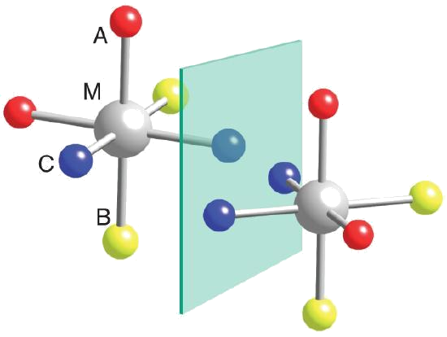

Slide 15
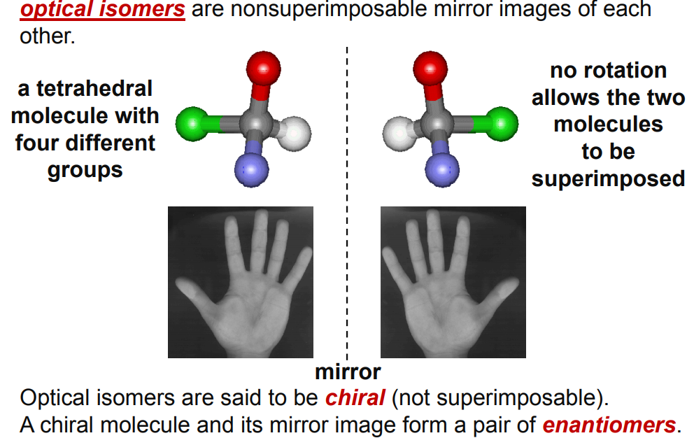

Slide 17
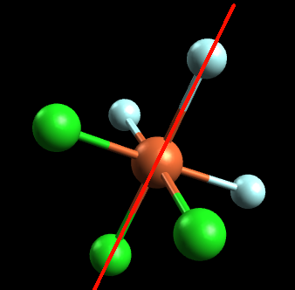
Is the octahedral compound FeCl₃F₃ optically active?
SUPERIMPOSIBLE
NO OPTICAL ACTIVITY

Slide 18
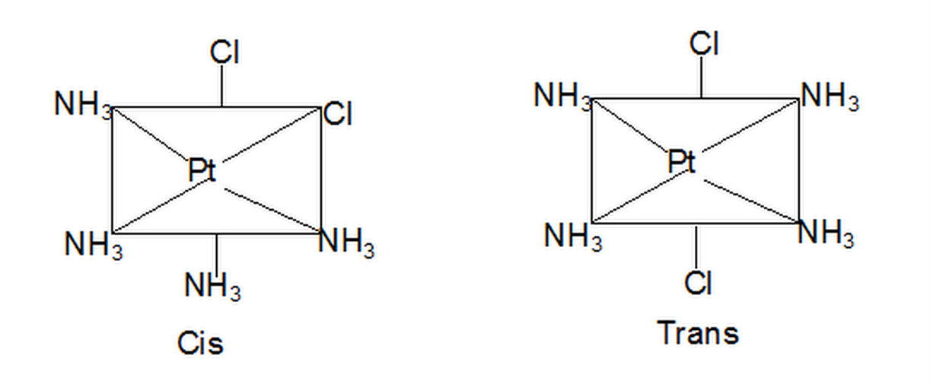
Geometric isomerism:
In disubstituted complexes, the substituted groups may be adjacent or opposite to each other. This gives rise to geometric isomerism. Thus square planar complexes such as [Pt(NH₃)₄Cl₂] can be prepared in two forms, cis and trans. When the chlorine atoms are adjacent to each other it is called cis form. While when two chlorine atoms are opposite it is called transform.

Slide 19
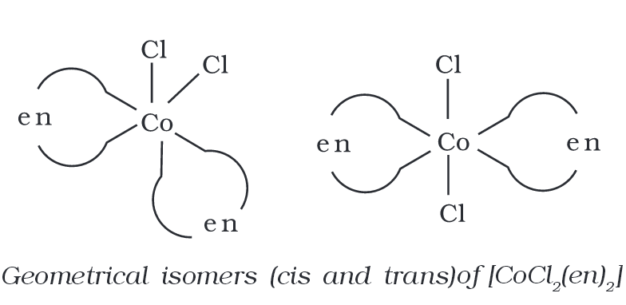
This type of isomerism takes place mainly in heteroleptic complexes because of the different possible geometric arrangements of ligands around the central metal atom.
This type of isomerism is mainly found in coordination compounds with coordination numbers 4 and 6.
In a square planar complex (i.e. coordination compounds with coordination number 4 which have [MX₂L₂] type formula (X and L are unidentate ligands), the two ligands X may be present adjacent to each other in a cis isomer, or opposite to each other to form a trans isomer.

Slide 20
Complex with co-ordination no-4
Ma₄ [Ni(CO)₄]
Ma₃b [Co(NH₃)₃Cl]²⁺
Ma₂b₂ [PtCl₂(NH₃)₂]
Ma₂bc [Co Cl₂ (NH₃)Br]
M(AA)₂ [Pt(en)₂]
M(AB)₂ [Pt(gly)₂]
M(abcd) [PtClBr(NH₃)(H₂O)]

Slide 21
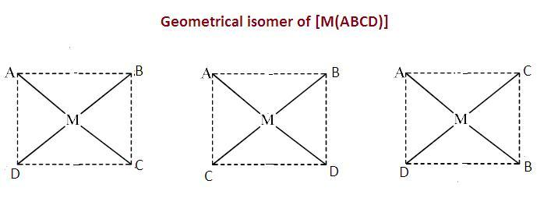

Slide 23
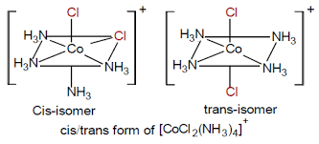
OCTAHEDRAL COMPLEX MA4B2

Slide 24
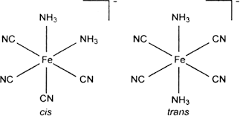
OTHER EXAMPLES OF MA4B2

Slide 25
MA2B2CD

Slide 26
M(AA)2B2

Slide 27
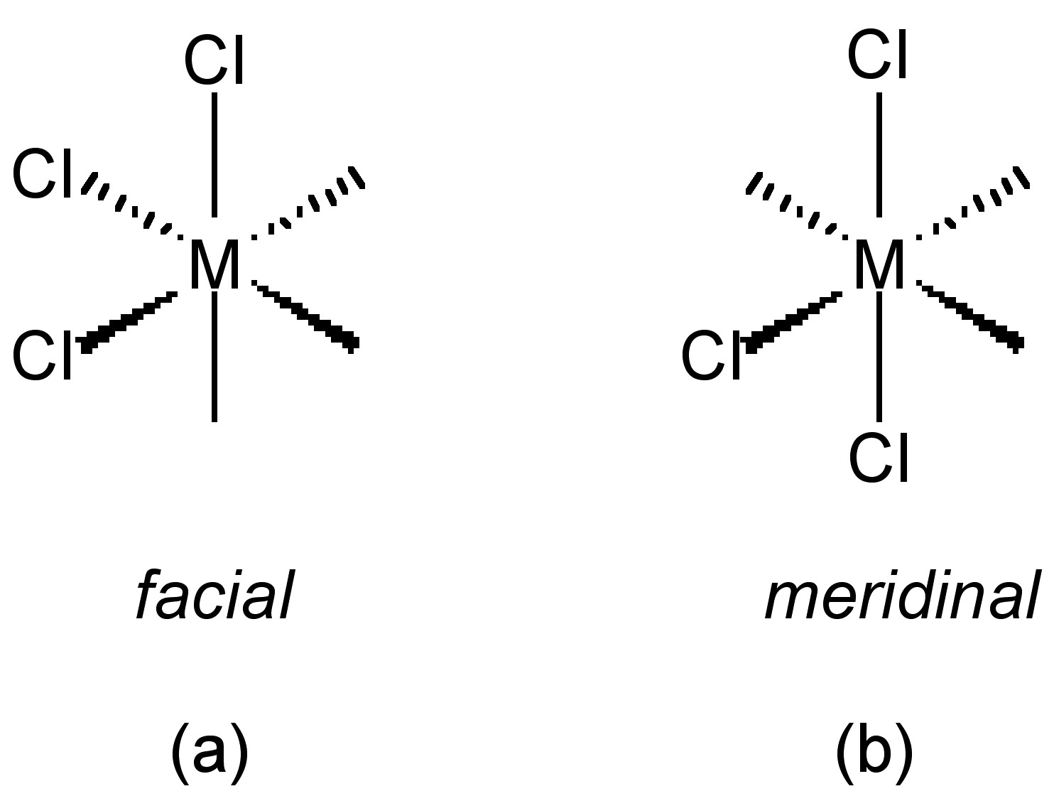
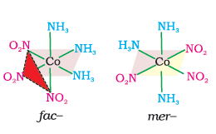
Fac and Mer Stereoisomers
When three identical ligands occupy one face of an octahedron, the isomer is said to be facial, or fac. In a fac isomer, any two identical ligands are adjacent or cis to each other. If these three ligands and the metal ion are in one plane, the isomer is said to be meridional, or mer.

Slide 28
